Slide 1
TEMPORAL LOGIC
What is Temporal Logic?
Temporal logic is a formal system used in the field of formal methods, which is a branch of computer science and mathematics that focuses on specifying, designing, and verifying systems and software.
Temporal logic extends classical logic by introducing operators that allow reasoning about the ordering of events over time.
Temporal logic allows time-related properties to be formally specified without introducing the explicit notion of time.
Temporal logic is particularly useful in formal verification, where the goal is to ensure that a system or software behaves according to specified requirements over time.
By using temporal logic, one can express and analyze temporal properties of a system, such as liveness (something good eventually happens) and safety (something bad never happens).

Slide 2
TEMPORAL LOGIC
Classical Logic V/S Temporal Logic
In classical logic:
formulas are evaluated within a single fixed world.
For example, a proposition such as “it is Monday” is either true or false.
Propositions are then combined using constructs such as ‘∧’, ‘¬’, etc.
In temporal logic:
evaluation takes place within a set of worlds. Thus, “it is Monday” may be satisfied in some worlds, but not in others.
The static notion of truth is replaced by a dynamic one
The formulas may change their truth values as the system evolves from state to state
The accessibility relation between worlds then describes a particular model of time.
The set of classical operators is extended with various temporal operators which navigate by this relation

Slide 3
TEMPORAL LOGIC
Role of Temporal Logic in Software Engineering
Temporal logic plays a crucial role in software engineering by providing a formal and systematic approach to express and verify temporal properties in software systems.
Specific areas where temporal logic is applied
Concurrency Control:
Temporal logic helps to ensure the correct execution order of concurrent operations in multi-threaded or distributed systems.
Example: Using temporal operators to express that a critical section must be accessed exclusively by one thread at a time, preventing data race conditions.
Real-Time Systems:
In real-time systems, timely execution of tasks is critical.
Temporal logic is employed to specify and verify temporal constraints on system responses.
Example: Ensuring that a control system responds to a sensor input within a specified time frame, expressed as a temporal property.

Slide 4
TEMPORAL LOGIC
Temporal Logic in Software Engineering
Fault Tolerance and Error Handling:
Temporal logic can express temporal properties related to fault tolerance and error recovery mechanisms in software systems.
Example: Specifying that a system should recover from a failure within a defined time period while maintaining correct functionality.
Temporal Specifications for System Behavior:
Temporal logic allows the formal specification of desired system behavior over time, providing a basis for system design and development.
Example: Defining a temporal property that specifies the correct sequence of user interactions in a graphical user interface (GUI) applications
Software Model Checking:
Temporal logic is a foundational component in software model checking, which involves exhaustively exploring the state space of a system to verify temporal properties.
Example: Verifying that a distributed system obeys to a specific protocol by expressing the protocol's temporal constraints using temporal logic.

Slide 5
TEMPORAL LOGIC
Temporal Logic in Software Engineering
Event-Based Systems:
Temporal logic is well-suited for expressing properties in event-driven or reactive systems where the system behavior is triggered by events over time.
Example: Specifying that an alarm should be triggered within a certain time after detecting a specific event in a monitoring system.
Temporal Aspects of Software Requirements:
Temporal logic helps in formalizing and verifying time-related requirements in software specifications.
Example: Expressing that a software system must generate a specific report every week without errors, using temporal operators to capture the periodicity.

Slide 6
TEMPORAL LOGIC
Temporal Logic
Commonly, propositional, discrete, linear temporal logic extends the descriptive power of propositional logic in order to be able to:
Describe sequences (hence: linear)
of distinct (hence: discrete) worlds
with each world being similar to a classical(propositional) model
So, we can equivalently describe the basis of our model of time in terms of a sequence of worlds, a sequence of states, or a sequence of propositional models.
Each state in the sequence is taken as modeling a different moment in time; hence the name temporal logic

Slide 7
TEMPORAL LOGIC
Types of Temporal Logic
There are two main types of temporal logic: linear temporal logic (LTL) and branching temporal logic (Computational Tree Logic (CTL)).
Linear Temporal Logic (LTL):
LTL deals with linear sequences of time, representing a single unfolding time line.
Operators in LTL include:
G (Globally): A property holds globally throughout the entire sequence.
F (Finally): A property will eventually hold at some point in the future.
X (Next): A property will hold in the next state.
U (Until): A property will hold until another property becomes true.
Branching Temporal Logic (CTL):
CTL is designed to reason about different possible branches of a computation.
Operators in CTL include:
A (For All): A property holds for all future states along all paths.
E (Exists): There exists a path along which a property holds.
CTL also includes the temporal operators G, F, X, and U, but they are interpreted differently than in LTL.

Slide 8
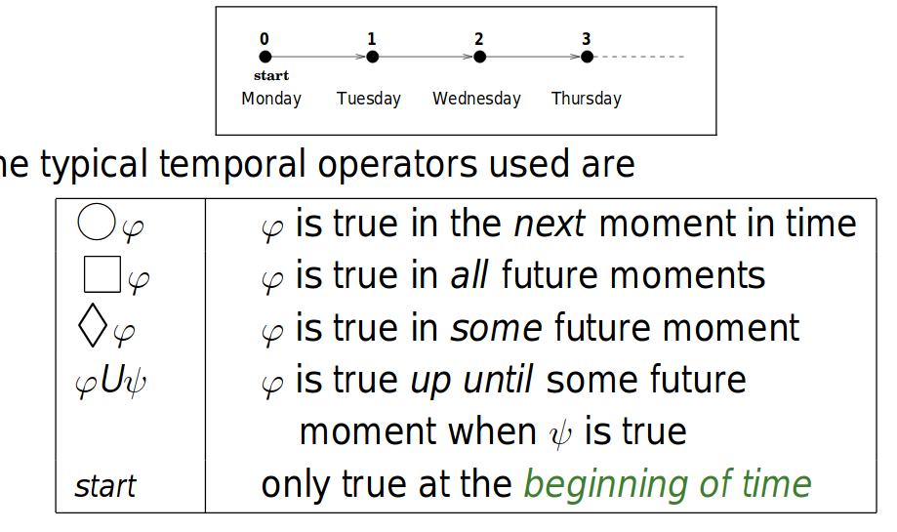
PTL IN A NUTSHELL
We use a simple temporal logic (PTL) where the accessibility relation characterizes a discrete, linear order isomorphic to the Natural Numbers, N
Typical Operators used

Slide 9
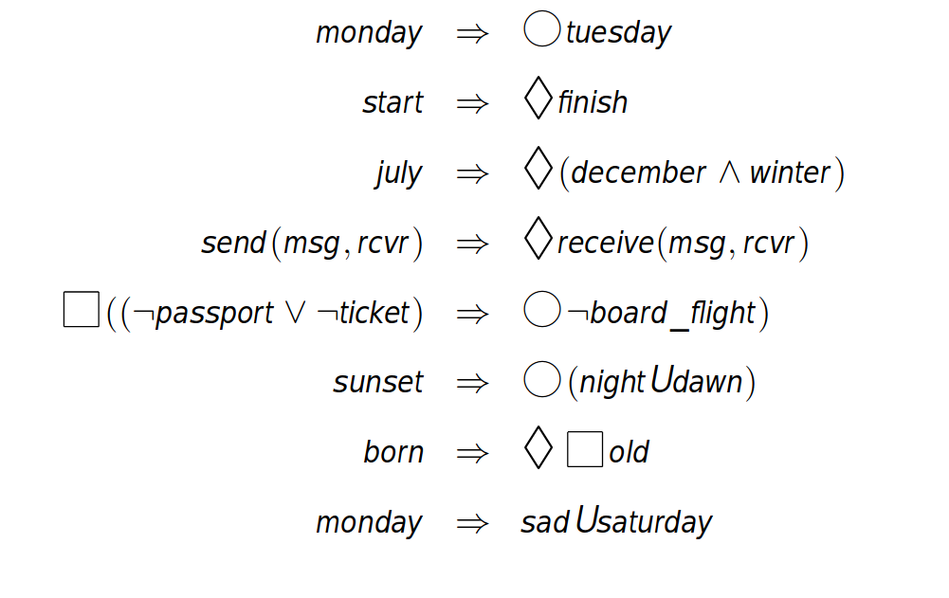
PTL EXAMPLES

Slide 10
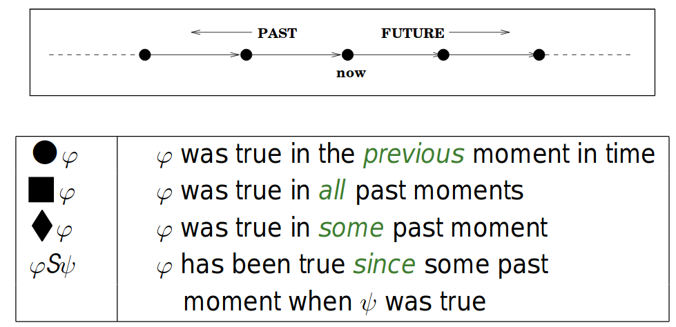
LOOKING BACK

Slide 11
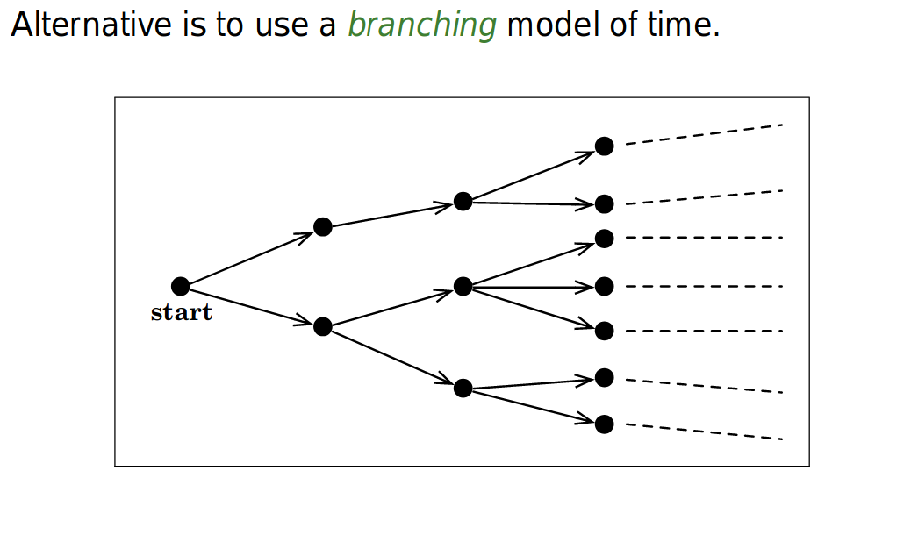
BRANCHING MODELS

Slide 12
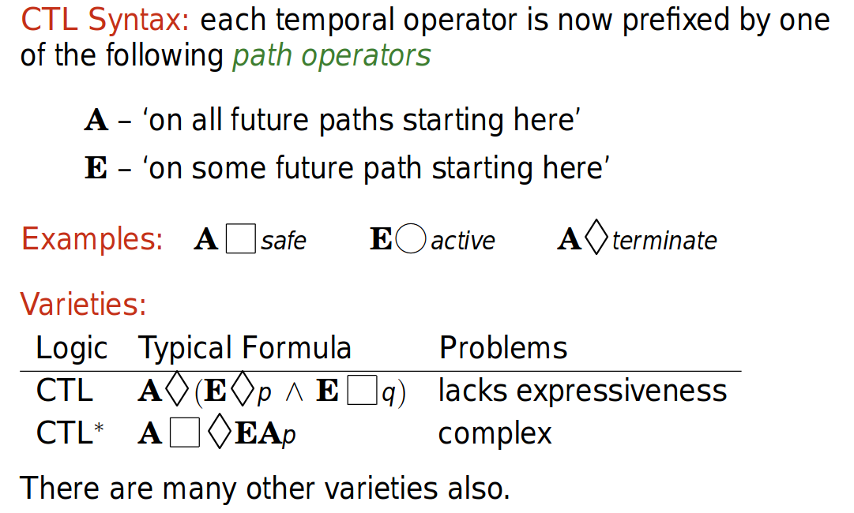
BRANCHING TEMPORAL LOGIC (COMPUTATIONAL TREE LOGIC)
Notes:
12

Slide 13
TEMPORAL LOGIC GETS EVERYWHERE
specification and verification of (dynamic) programs
specification and verification of distributed and concurrent programs
representation of tense in natural language
characterizing temporal database queries
verification of finite state models derived from ‘real’ systems (model checking)
agent theory
direct execution
real-time analysis
temporal data mining
exploring the limits of decidability

Slide 14
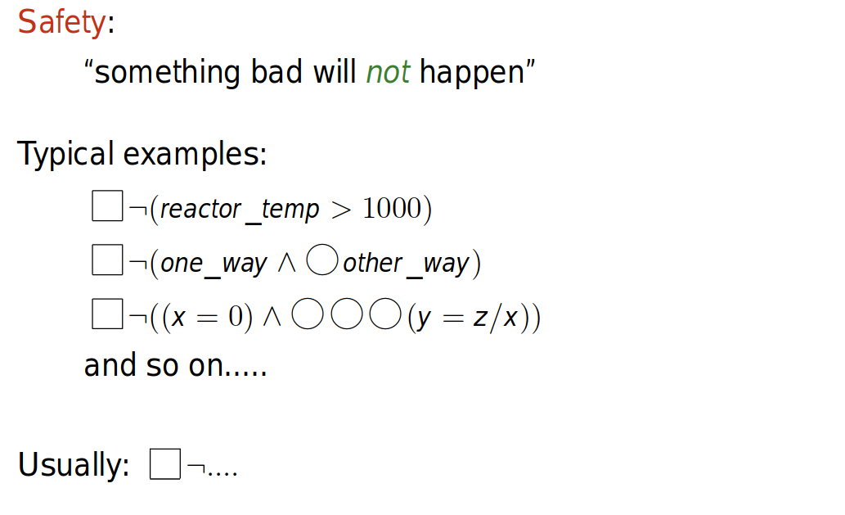
INTUITION: SAFETY PROPERTY

Slide 15
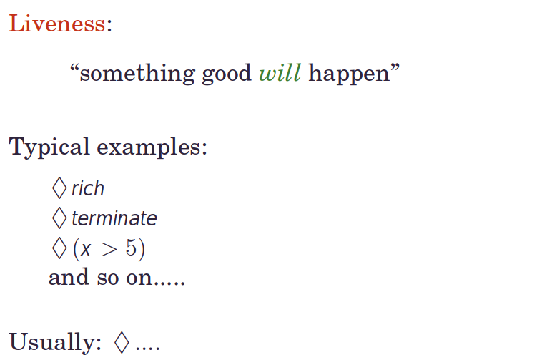
INTUITION: LIVENESS PROPERTY

Slide 16
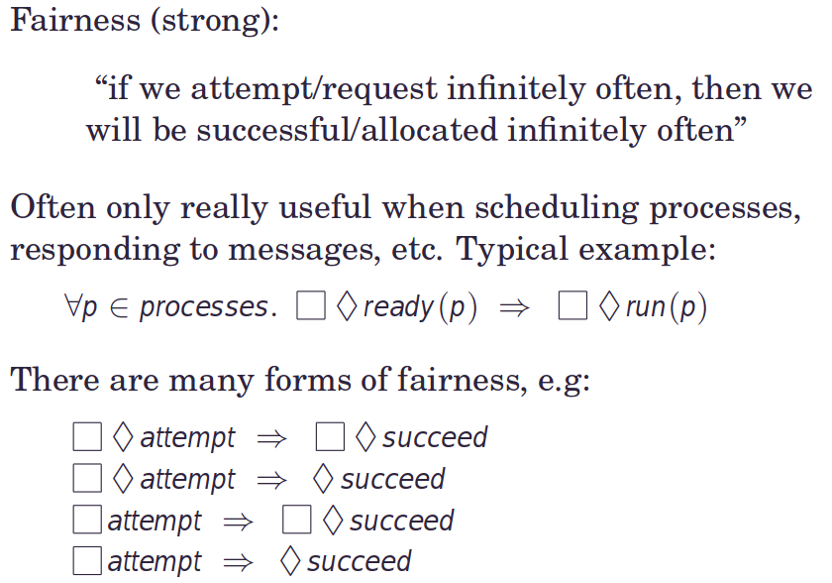
INTUITION: FAIRNESS PROPERTY

Slide 17
TEMPORAL LOGIC
Temporal logic is commonly used to specify various properties in software systems.
1) Real-Time System: Deadline Constraint
Temporal Logic Specification: G(request→(Xgrant∧(grant→Fresponse)))
Interpretation: Whenever a request is made, it should be followed by an immediate grant, and subsequently, there must be a response. This ensures a real-time deadline constraint.
2)Concurrency Control in a Database System
Temporal Logic Specification: G(¬(transaction_1∧transaction_2))
Interpretation: It is always the case that transactions 1 and 2 are not executed concurrently. This expresses a property of mutual exclusion in a database system.
3) Fault Tolerance in a Redundant System
Temporal Logic Specification: G(¬(failure_1∧failure_2))
Interpretation: It is always the case that failures 1 and 2 do not occur simultaneously. This specifies a fault-tolerance property in a redundant system.

Slide 18
TEMPORAL LOGIC
Temporal logic is commonly used to specify various properties in software systems.
4) Robot Navigation System
Temporal Logic Specification: G(start→(X(move∧¬obstacle)∧Fgoal))
Interpretation: Once the robot starts, in the next state, it should move without encountering obstacles, and eventually, it should reach the goal. This specifies the navigation behavior of a robot.
5) Network Communication
Temporal Logic Specification: G(sender→(X(send∧¬collision)∧Freceiver))
Interpretation: Whenever a sender initiates communication, in the next state, it should send the message without collision, and eventually, the receiver should receive the message.
6) User Authentication System
Temporal Logic Specification: G(¬(login_attempt∧login_failure))
Interpretation: It is always the case that login attempts and login failures do not occur simultaneously. This specifies a safety property in a user authentication system.

Slide 19
TEMPORAL LOGIC
Temporal logic is commonly used to specify various properties in software systems.
7) Elevator Control System
Temporal Logic Specification: G(¬(door_open∧moving))
Interpretation: It is always the case that the door is not open while the elevator is in motion. This expresses a safety property in an elevator control system.
8) Web Server Performance
Temporal Logic Specification: G(request→(Xresponse∧F(response_time<threshold)))
Interpretation: Whenever a request is made, in the next state, there should be a response, and eventually, the response time should be less than a specified threshold.

Slide 20
TEMPORAL LOGIC (Some Questions)
Temporal Logic Specification:
Given the temporal logic specification G(request→(Xresponse∧F(response_time<threshold))), explain its meaning in the context of the web server performance system.
Safety Property:
Define a safety property related to web server performance that could be expressed using temporal logic. Provide a temporal logic formula for this safety property and explain its significance.
Liveness Property:
Define a liveness property related to web server performance that could be expressed using temporal logic. Provide a temporal logic formula for this liveness property and explain its significance.
Concurrency Control:
Discuss how temporal logic can be used to specify concurrency control aspects in the web server performance system. Provide an example of a temporal logic formula that ensures proper concurrency control.
Real-Time Constraint:
Consider the real-time constraint specified in G(request→(Xresponse∧F(response_time<threshold))). Explain why this constraint is important for the web server performance system and discuss potential consequences if this constraint is not satisfied.
Extension: Fault Tolerance:
Propose a temporal logic formula to express a fault tolerance property in the context of web server performance. Explain the nature of the fault tolerance property and how the temporal logic formula ensures fault tolerance.

Slide 21
Consider a scenario and formulate temporal logic specifications to capture certain properties related to that scenario.
1) Imagine an elevator control system with the following characteristics:
The elevator has multiple floors (e.g., Ground, Floor 1, Floor 2).
Passengers can request the elevator to move to a specific floor.
The elevator should follow certain safety and liveness properties.
Temporal logic Specification
1) Safety Property - Door and Movement:
Scenario: The elevator doors should remain closed while the elevator is in motion.
Temporal Logic Specification: G(¬(door_open∧moving))
Interpretation: It is always the case that the door is not open while the elevator is in motion.
2) Liveness Property - Response to Requests:
Scenario: Whenever a passenger requests the elevator, the elevator should eventually arrive at that floor.
Temporal Logic Specification: G(request→(Xarrival∧Fdoor_open))
Interpretation: Whenever a passenger requests the elevator, in the next state, the elevator should arrive, and eventually, the door should open.

Slide 22
Consider a scenario and formulate temporal logic specifications to capture certain properties related to that scenario.
3) Concurrency Control - Mutual Exclusion of Floors:
Scenario: The elevator should not serve multiple floors simultaneously.
Temporal Logic Specification: G(¬(at_floor_1∧at_floor_2))
Interpretation: It is always the case that the elevator is not at both Floor 1 and Floor 2 simultaneously.
4) Fault Tolerance - Emergency Stop:
Scenario: In case of an emergency, the elevator should immediately stop.
Temporal Logic Specification: G(emergency_stop→Xstopped)
Interpretation: If there is an emergency stop, in the next state, the elevator should be stopped.
5) Real-Time Constraint - Maximum Response Time:
Scenario: The elevator should respond to a request within a specified time.
Temporal Logic Specification: G(request→(Xarrival∧F(response_time<threshold)))
Interpretation: Whenever a passenger requests the elevator, in the next state, the elevator should arrive, and eventually, the response time should be less than a specified threshold.
These temporal logic specifications help ensure safety, liveness, concurrency control, fault tolerance, and real-time constraints in the elevator control system.

Slide 23
Consider a scenario and formulate temporal logic specifications to capture certain properties related to that scenario.
2) You have an intersection with traffic lights controlling the flow of traffic.
The intersection has lights for North-South (NS) and East-West (EW) directions.
Vehicles are expected to follow traffic rules, and
the traffic lights should operate according to a set sequence.
Temporal logic Specification
1) Safety Property - No Conflicting Lights:
Scenario: There should not be a situation where both NS and EW lights are green simultaneously.
Temporal Logic Specification: G(¬(NS_green∧EW_green))
Interpretation: It is always the case that both NS and EW lights are not green simultaneously.
2) Liveness Property - Fairness in Light Switching:
Scenario: Each direction should have a fair chance to get a green light.
Temporal Logic Specification: G(F(NS_green))∧G(F(EW_green))
Interpretation: It is always the case that eventually NS will get a green light, and it is always the case that eventually EW will get a green light.

Slide 24
Consider a scenario and formulate temporal logic specifications to capture certain properties related to that scenario.
3) Concurrency Control - Exclusive Green Lights:
Scenario: At any given time, only one direction should have a green light.
Temporal Logic Specification: G(¬(NS_green∧EW_green))
Interpretation: It is always the case that both NS and EW lights are not green simultaneously, ensuring exclusive green lights.
4) Real-Time Constraint - Minimum Green Light Duration:
Scenario: Each green light should have a minimum duration to allow sufficient time for traffic flow.
Temporal Logic Specification: G(NS_green→(XNS_green∧F(duration≥min_duration)))
Interpretation: Whenever NS gets a green light, in the next state, NS should still have a green light, and eventually, the duration should be greater than or equal to a minimum threshold.
5) Fault Tolerance - Emergency Stop:
Scenario: In case of a system malfunction or emergency, the lights should immediately switch to a safe state.
Temporal Logic Specification: G(emergency_stop→X(NS_red∧EW_red))
Interpretation: If there is an emergency stop, in the next state, both NS and EW lights should be red.

Slide 25
Consider a scenario and formulate temporal logic specifications to capture certain properties related to that scenario.
3) You have a vending machine that dispenses different types of beverages (e.g., coffee, tea, and soda). Customers insert money, make a selection, and receive their chosen beverage.
Temporal logic Specification
1) Safety Property - Proper Change Dispensing:
Scenario: When a customer makes a purchase, the vending machine should dispense the correct change.
Temporal Logic Specification: G(purchase→(Xchange_dispensed∧F(correct_change)))
Interpretation: Whenever a customer makes a purchase, in the next state, change should be dispensed, and eventually, it should be the correct amount.
2) Liveness Property - Availability of All Beverages:
Scenario: All available beverages should be accessible to customers.
Temporal Logic Specification: G(F(coffee))∧G(F(tea))∧G(F(soda))
Interpretation: It is always the case that eventually coffee, tea, and soda will be available for selection.

Slide 26
Consider a scenario and formulate temporal logic specifications to capture certain properties related to that scenario.
3) Concurrency Control - One Purchase at a Time:
Scenario: Only one customer should be able to make a purchase at a time.
Temporal Logic Specification: G(¬(purchase∧Xpurchase))
Interpretation: It is always the case that purchases are not made simultaneously, ensuring only one customer can make a purchase at a time.
Real-Time Constraint - Maximum Transaction Time:
Scenario: Each transaction, from money insertion to beverage dispensing, should take less than a specified maximum time.
Temporal Logic Specification: G(money_inserted→(Xbeverage_dispensed∧F(transaction_time<max_time)))
Interpretation: Whenever money is inserted, in the next state, a beverage should be dispensed, and eventually, the transaction time should be less than the maximum allowed time.
Fault Tolerance - Refund for Out-of-Stock Item:
Scenario: If a selected beverage is out of stock, the vending machine should refund the customer.
Temporal Logic Specification: G(out_of_stock→Xrefund_issued)
Interpretation: If a selected beverage is out of stock, in the next state, a refund should be issued.

Slide 27
Consider a scenario and formulate temporal logic specifications to capture certain properties related to that scenario.
4) An access control system is in place to manage entry and exit through an automated door in a secure facility. Authorized personnel use keycards to access the facility.
Temporal logic Specification
1) Safety Property - Door Locking Mechanism:
Scenario: The automated door should remain locked when not in use.
Temporal Logic Specification: G(¬(access_requested∧door_unlocked))
Interpretation: It is always the case that when access is not requested, the door remains locked.
Liveness Property - Access for Authorized Personnel:
Scenario: Authorized personnel should be able to access the facility when needed.
Temporal Logic Specification: G(authorized→(Xaccess_requested∧F(door_unlocked)))
Interpretation: It is always the case that if a person is authorized, in the next state, access should be requested, and eventually, the door should be unlocked.

Slide 28
Consider a scenario and formulate temporal logic specifications to capture certain properties related to that scenario.
3) Concurrency Control - Exclusive Access Request:
Scenario: Only one person should be able to request access at a time.
Temporal Logic Specification: G(¬(access_requested∧Xaccess_requested))
Interpretation: It is always the case that access requests are not made simultaneously, ensuring exclusive access request control.
Real-Time Constraint - Time-Limited Access:
Scenario: Once access is granted, it should be valid for a specified duration.
Temporal Logic Specification: G(door_unlocked→(Xdoor_unlocked∧F(access_duration<max_duration)))
Interpretation: If the door is unlocked, in the next state, the door should remain unlocked, and eventually, the access duration should be less than the maximum allowed duration.
Fault Tolerance - Emergency Lockdown:
Scenario: In case of an emergency or security threat, the system should immediately initiate a lockdown.
Temporal Logic Specification: G(emergency_triggered→Xdoor_locked)
Interpretation: If there is an emergency triggered, in the next state, the door should be locked.

Slide 29
Consider a scenario and formulate temporal logic specifications to capture certain properties related to that scenario.
5) In a smart home, there is an automated temperature control system that regulates the heating and cooling devices based on user preferences. The system maintains a comfortable temperature inside the home.
Temporal logic Specification
1) Safety Property - Temperature Range:
Scenario: The temperature inside the home should always be within a safe and comfortable range.
Temporal Logic Specification: G(temperature≥min_temperature∧temperature≤max_temperature)
Interpretation: It is always the case that the temperature is greater than or equal to the minimum temperature and less than or equal to the maximum temperature.
Liveness Property - User-Set Temperature Achieved:
Scenario: If a user sets a specific temperature, the system should eventually achieve and maintain that temperature.
Temporal Logic Specification: G(user_set_temperature→(Xsystem_achieved_temperature∧F(system_temperature=user_set_temperature)))
Interpretation: It is always the case that if a user sets a temperature, in the next state, the system should achieve that temperature, and eventually, the system's temperature should be equal to the user-set temperature.

Slide 30
Consider a scenario and formulate temporal logic specifications to capture certain properties related to that scenario.
3) Concurrency Control - Exclusive Heating and Cooling:
Scenario: The heating and cooling systems should not operate simultaneously.
Temporal Logic Specification: G(¬(heating∧cooling))
Interpretation: It is always the case that the heating and cooling systems are not operating simultaneously, ensuring exclusive use of these systems.
Real-Time Constraint - Temperature Change Rate:
Scenario: The rate of temperature change should not exceed a specified maximum.
Temporal Logic Specification: G(¬(Xtemperature_change∧¬(temperature_change_rate≤max_change_rate)))
Interpretation: It is always the case that if there is a temperature change, in the next state, the temperature change rate should be less than or equal to the maximum allowed change rate.
Fault Tolerance - Emergency Shutdown:
Scenario: In case of a malfunction or emergency, the temperature control system should immediately shut down.
Temporal Logic Specification: G(emergency_shutdown→Xsystem_shutdown)
Interpretation: If there is an emergency shutdown, in the next state, the system should be shut down.

Slide 31
Temporal Logic (Model Checking)
Explain the concept of model checking in the context of temporal logic. Provide an overview of how model checking can be used to verify system properties expressed in temporal logic. Discuss the advantages and limitations of model checking in the verification

Slide 32
Model Checking
Model checking?
Model checking is a formal verification technique used in computer science and software engineering to ensure that a system or a model meets specified properties or requirements.
In the field of formal methods, it involves mathematically rigorous techniques for the specification, design, and verification of software and hardware systems.
In the context of temporal logic, model checking involves systematically exploring all possible states of a system to verify whether a given temporal logic formula holds in each state or along each path.
In model checking:
, a system is represented as a formal model, often in the form of a finite-state model, such as a state transition system or a labeled transition system.
Additionally, temporal logic is often employed to express properties or requirements that the system should satisfy over time.

Slide 33
Model Checking
Model checking?
model checking, when used in conjunction with temporal logic, is a powerful technique for systematically verifying the correctness of a system with respect to specified temporal properties.
The basic idea of model checking is:
to systematically explore all possible states of the system and verify whether the specified properties hold in each state.
This exploration is typically done algorithmically, with the help of efficient data structures and algorithms that traverse the state space of the system.
If the model checking algorithm finds a counterexample where the system violates the specified properties, it provides valuable information about the nature of the problem.

Slide 34
Model Checking
Key Components:
1) Formal Model: Model checking relies on a formal representation of the system. Common formalisms include finite-state machines, transition systems, or Petri nets.
2) Temporal Logic Properties: The properties to be checked are expressed using temporal logic, such as Linear Temporal Logic (LTL) or Branching Temporal Logic (CTL).

Slide 35
Model Checking
Model Checking Process/Key steps in model checking
1) Model Representation: Formally define the system or software as a mathematical model, often using a formalism like state machines, transition systems, or Petri nets.
2) Property Specification: Clearly express the desired properties or requirements using formal languages, commonly temporal logics such as Linear Temporal Logic (LTL) or Computational Tree Logic (CTL).
3) State Space Exploration: Employ algorithms to systematically explore all possible states of the system. This can involve techniques like breadth-first or depth-first search, symbolic model checking, or other specialized algorithms.
4) Property Verification: Check whether the specified properties hold in each explored state. If a violation is found, the model checker typically provides a counterexample to illustrate the problematic behavior.

Slide 36
Model Checking
Types of Model Checking:
Symbolic Model Checking: Utilizes symbolic representations to handle large state spaces more efficiently. Binary decision diagrams (BDDs) are commonly used in symbolic model checking.
Explicit Model Checking: Explores the state space explicitly without symbolic representations. Suitable for smaller systems but may face scalability issues for larger ones.

Slide 37
Model Checking
Temporal Logic in Model Checking:
LTL (Linear Temporal Logic): LTL is used to express properties that evolve over time in a linear sequence. Model checking with LTL involves verifying whether the system satisfies the specified temporal logic formula.
CTL (Computational Tree Logic): CTL is suitable for systems with multiple concurrent processes. It allows the specification of properties along different paths in the system's execution tree.

Slide 38
Model Checking
Model Checking Tools:
SPIN: A widely used model checker for verifying distributed software systems. It supports both LTL and Promela (Process Meta Language).
NuSMV: An open-source model checker supporting both symbolic and explicit model checking. Particularly suitable for hardware and software systems.
PRISM: Primarily used for probabilistic model checking, PRISM is a tool for verifying systems with probabilistic and nondeterministic behavior.

Slide 39
Temporal Logic (Model Checking)
How model checking can be used to verify system?
1) Model Representation
A system is represented as a formal model, typically a finite state model or a transition system.
2)Temporal Logic Formulas:
Properties of interest are expressed using temporal logic formulas, such as Linear Temporal Logic (LTL) or Branching Temporal Logic (CTL).
3)Traversal and Verification:
The model checker systematically explores the state space of the system, traversing the possible states and transitions.
4) Verification Against Formulas:
At each state or along each path, the model checker evaluates the specified temporal logic formulas to check whether the desired properties hold.
5) Counterexample Generation:
If a violation is found, the model checker can provide a counterexample—a specific sequence of states or transitions that demonstrates the failure of the specified property.

Slide 40
Temporal Logic (Model Checking)
Advantages of Model Checking
1) Automation:
Model checking is an automated process, reducing the need for manual inspection and providing a systematic approach to verification.
2)Completeness:
Model checking explores the entire state space, providing completeness in checking all possible scenarios.
3) Early Detection of Issues:
Model checking can detect issues early in the development process, allowing for timely corrections and improvements.
4) Formal Specification:
Temporal logic formulas provide a formal and expressive way to specify properties, making them suitable for model checking.

Slide 41
Temporal Logic (Model Checking)
Limitations of Model Checking
1) State Explosion Problem:
For large and complex systems, the state space can become exponentially large, leading to the "state explosion" problem.
2) Precision vs. Expressiveness:
Balancing precision and expressiveness in temporal logic formulas can be challenging.
3) Property Specification:
The effectiveness of model checking relies on the accuracy of the specified properties. Incorrect or incomplete specifications may lead to false results.

